Slide 1

Golden Grain Bakery: Business Performance Overview
Strategic Analysis & Recommendations
by Priya Govindarajan
$185.07M Revenue | 96.42M Units | 389 Customers

Slide 2
Executive Summary
1
Company Performance
2
Division Overview
$185.07M revenue, 3.2% growth, 96.42M units across 27 products, 389 customers, $475K avg. lifetime value.
Division A: 60% restaurant, 40% grocery. Division B: 78% grocery, 22% restaurant.
3
Key Insights
4
Strategic Direction
Division B declining 8.7% due to grocery competition. $40.7M (22%) revenue from customer overlap, 35% higher margins.
Expand Division B's restaurant presence 15% in 18 months, leverage cross-selling to increase retention 12%.

Slide 3




Key Takeaways
Replicate Division A's Success
Division A provides a proven model. Division B can emulate its channel distribution.
Sales Performance Monitoring
Track 2021 projections carefully. Validate recovery assumptions at each milestone.
Data Architecture Priorities
Centralize data sources through Azure. Ensure consistent data for better analysis.
Phased Implementation Approach
Expand restaurants and standardize prices first. Then align products and convert customers.

Slide 4
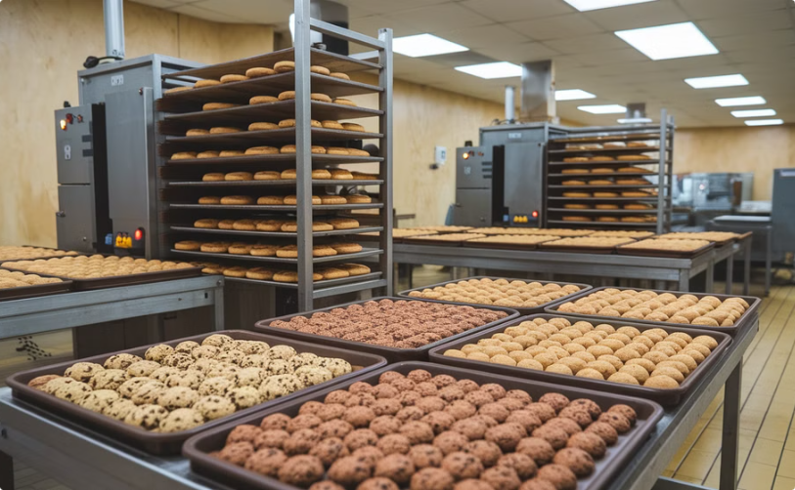

Company Structure
Division A
Division B
Broad geographic footprint across U.S. and Canada
Concentrated in southern/western U.S. and Puerto Rico
Specializes in crackers and cookies
Specializes in crisps and muffins
Balanced channel strategy (restaurants and grocery)
Primary focus on grocery channel (90% of revenue)

Slide 5

Performance at a Glance
1
Strong Market Presence
2
Division Performance
$185.07M total revenue with diversified product portfolio
Division A shows growth while Division B faces challenges
3
Customer Overlap
4
COVID-19 Impact
14.4% of customers purchase from both divisions, generating 22% of revenue
2020 performance down 20% with ambitious recovery targets for 2021

Slide 6
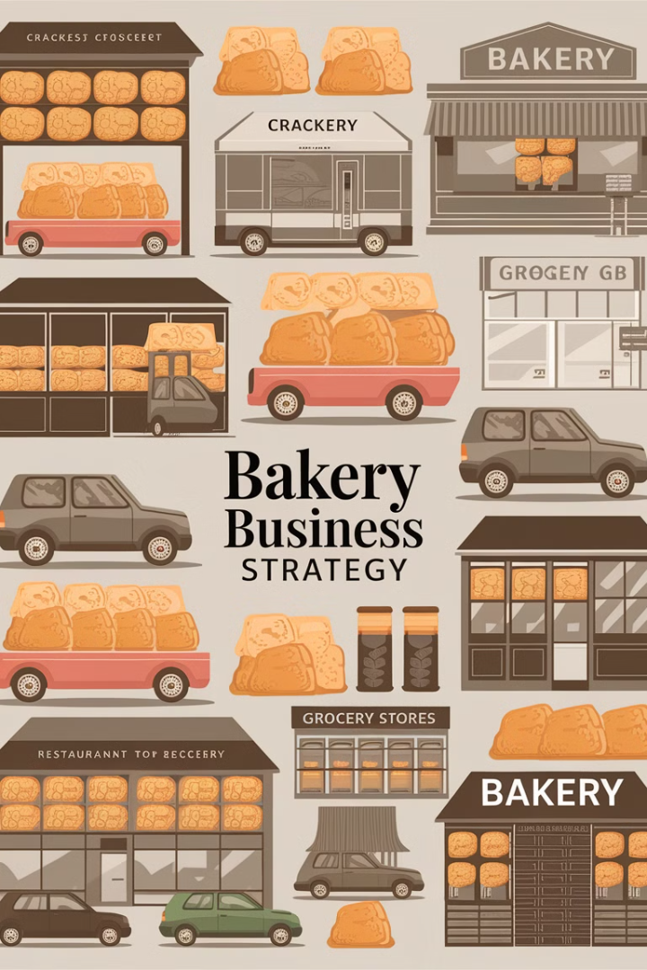
Division A: Strategic Strengths
Balanced Channel Strategy
60% restaurants, 40% grocery – optimal market coverage
Product Leadership
Dominates in crackers (10M+ boxes) with strong cookies position
Strategic Alignment
Branded products in restaurants, PL focus in grocery
Pricing Consistency
Stable pricing builds customer trust and forecasting reliability

Slide 7
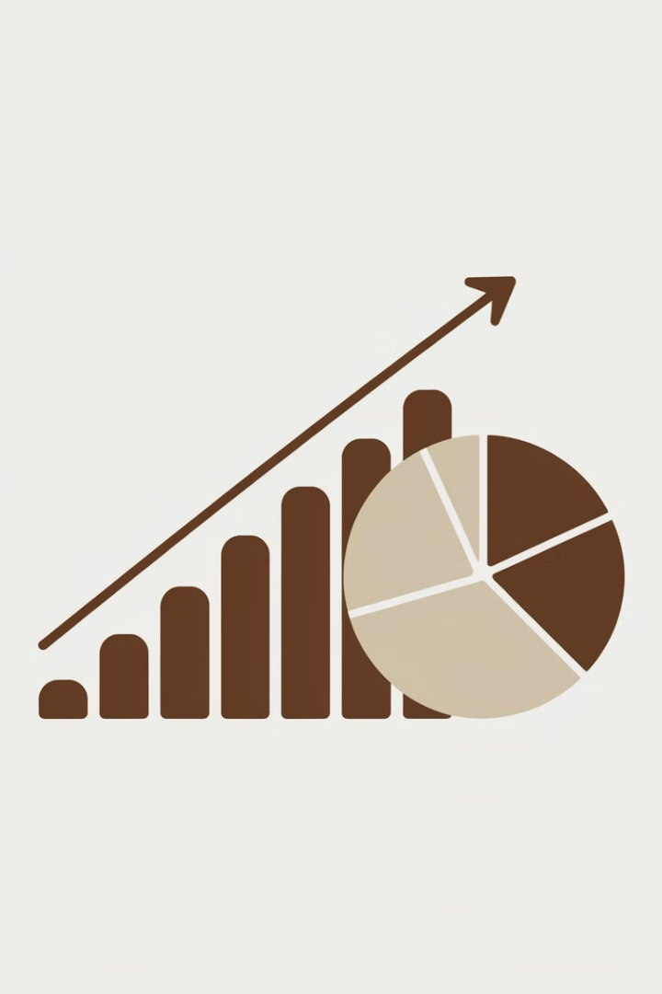




Division A: Market Performance
Upward Trajectory
Restaurant Strength
Premium Positioning
Consistent revenue growth over time
Higher volumes despite equal customer distribution
Branded bread products command higher margins
Geographic Advantage
Spans multiple U.S. states and Canada

Slide 8




Division B: Current Challenges
Channel Concentration Risk
Scale Disadvantage
90% revenue from grocery despite restaurants being higher-margin
1
2
1M total units vs. Division A's 14M
Declining Revenue Trend
4
3
Limited Geographic Reach
Requires immediate strategic intervention
Concentrated in select regions

Slide 9

Division B: Growth Opportunities
Portfolio Expansion
Premium PL Strategy
Potential to leverage Division A best practices
Product Specialization
Unique premium positioning for PL crisps
Restaurant Expansion
Strong expertise in crisps and muffins
50% gap between current (10%) and company average (60%)

Slide 10
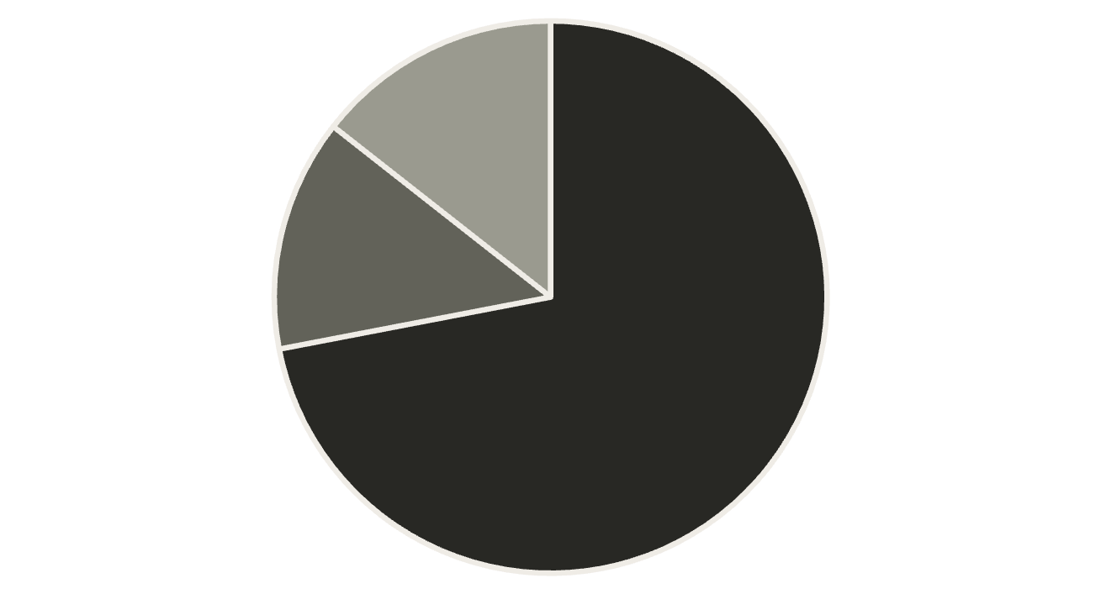
Customer Overlap: A Strategic Asset
Division A Only
Division B Only
Both Divisions
56 customers (14.4%) purchase from both divisions, generating 22.03% of total revenue.
280 customers exclusive to Division A, 53 exclusive to Division B.

Slide 11
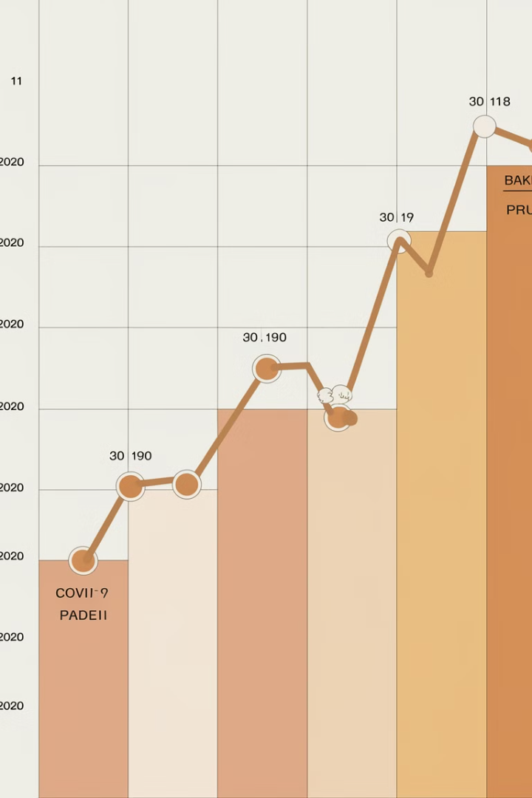
Sales Performance: 2018-2020
1
2018
Exceptional growth with $60M revenue increase
2
2019
Growth stabilization with modest gains
3
2020
Significant $40M decline (-20% YoY) due to COVID-19
Overall: $20M net positive variance over the three-year period

Slide 12
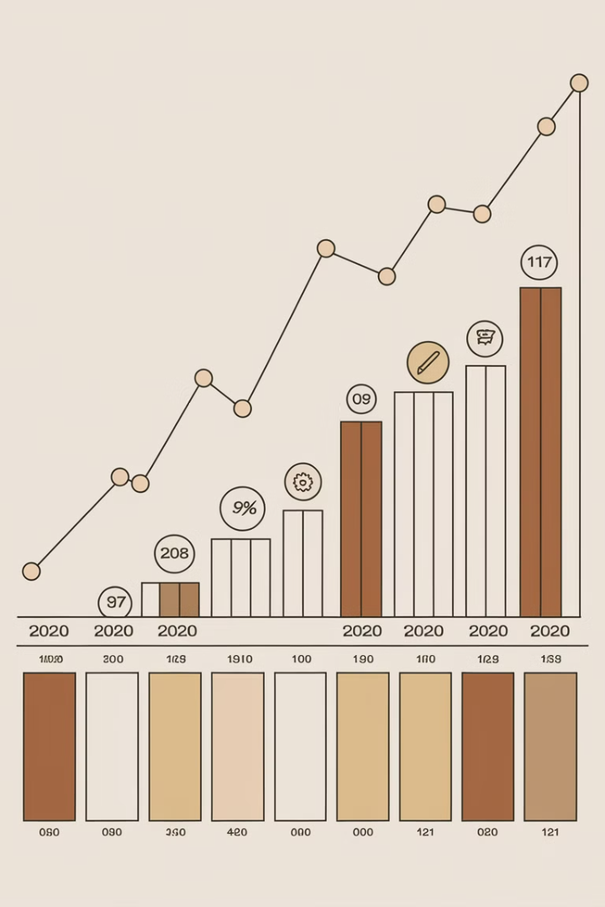




2021 Forecast: Ambitious Recovery
Exceeds Pre-Pandemic
2021 projection significantly exceeds pre-pandemic performance
Accelerated Growth
Forecast assumes accelerated growth, not just recovery
Validation Required
Key growth drivers require validation and tracking
Milestone Metrics
Progress indicators needed to monitor recovery

Slide 13
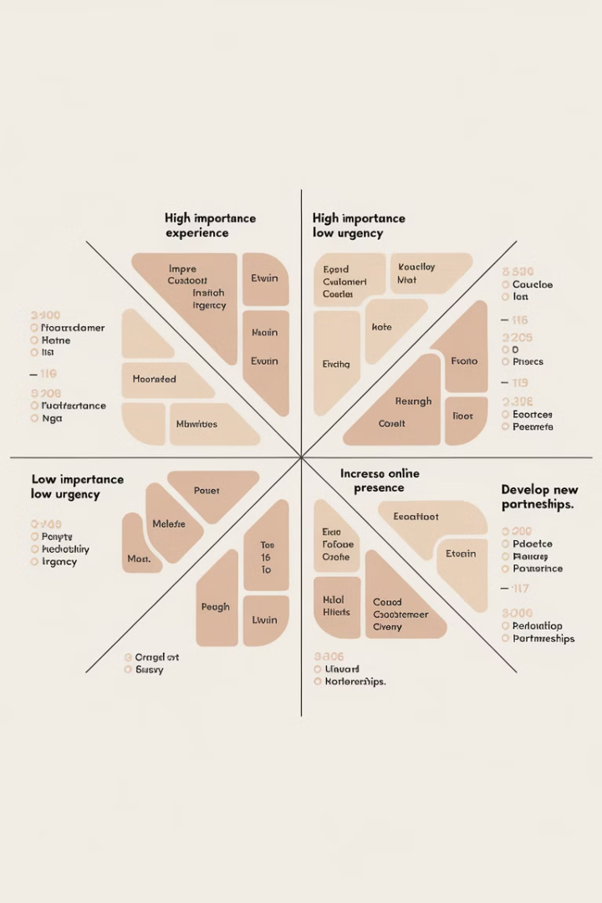
Strategic Priorities
1
Division B Restaurant Expansion
Implement phased approach to increase restaurant penetration from 10% to 30%
2
Cross-Division Knowledge Transfer
Apply Division A's channel strategy expertise to Division B
3
Customer Cross-Selling
Target Division A-only customers for Division B products
4
Pricing Discipline
Standardize pricing approach across both divisions

Slide 14



Modernizing Data Architecture
Power BI
1
Reporting and dashboards
Azure Data Factory or Fivetran
2
Automated data integration
Azure SQL Database or Snowflake
3
Central data warehouse
Current State: Three disconnected data sources (SQL Server, SaaS budgeting app, Excel)
Key Benefits: Automation, reliability, consistency, and scalability

Slide 15
Path Forward
Phase 1 (Q2 2025)
1
Data integration and standardization
Phase 2 (Q3 2025)
2
Division B restaurant channel expansion
Phase 3 (Q4 2025)
3
Cross-division product strategy implementation
Phase 4 (Q1 2026)
4
Customer overlap strategy execution
Expected Outcome: 15% revenue growth by end of 2026

Slide 16

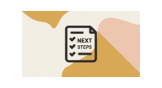


Discussion
Key questions for consideration
Immediate next steps
Priya Govindarajan, Analytics Consultant

